Slide 1
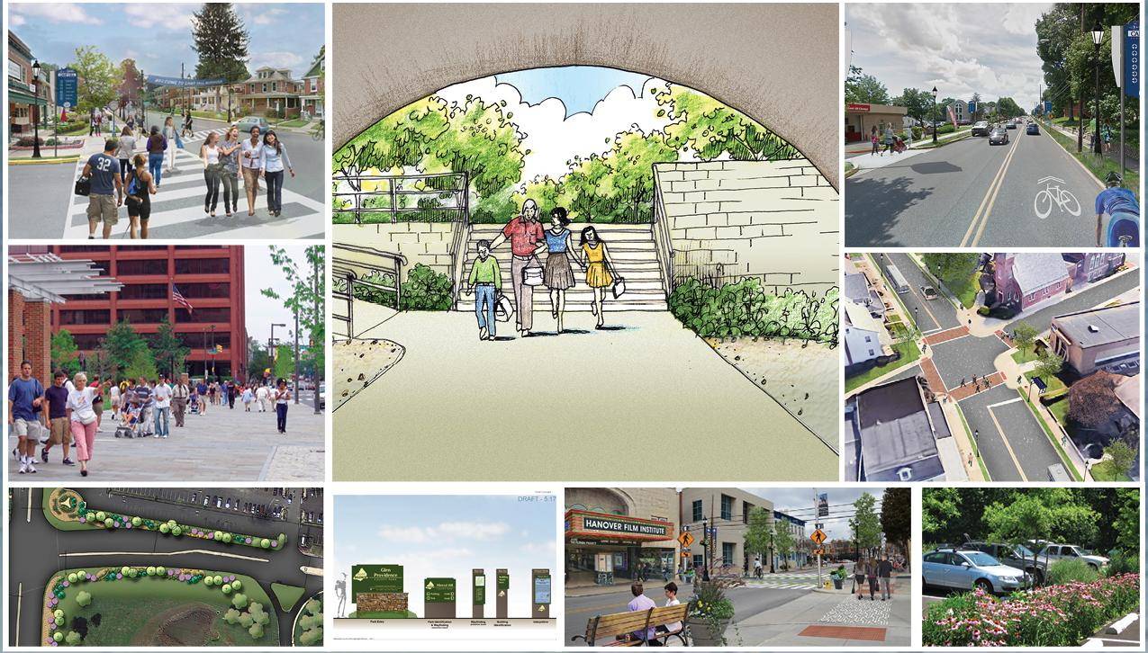
Borough of Pottstown
Streetscape Design Guidelines
and Master Plan
Streetscape Design Guidelines
and Master Plan
September 18, 2025 – Public Meeting

Slide 2
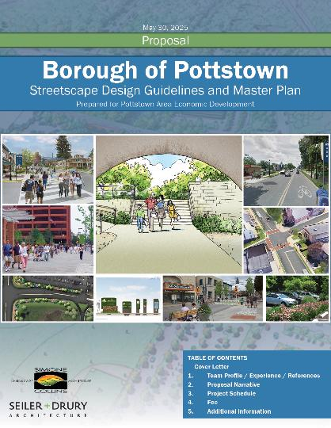
Pottstown Area Economic Development (PAED) is seeking to develop a comprehensive Streetscape
Plan & Design for Pottstown’s downtown.
The improvements are intended to elevate the perception of the downtown commercial core,
West High Street, & the Circle of Progress areas.
Our tasks are focused on PHYSICAL IMPROVEMENTS.
Façade and streetscape recommendations should be realistic and financially feasible.

Slide 3
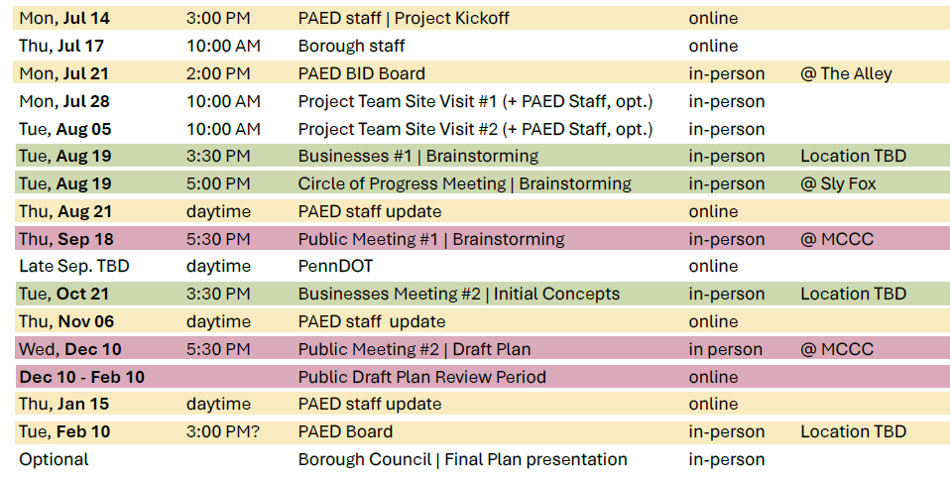
Schedule

Slide 4
Thank you for your time this evening!
Our team brings nearly 3 decades of work experience in Pottstown married with “fresh eyes” to recommend some next steps in Pottstown’s continuing story of revitalization.
  Project Team
    Peter Simone, RLA, FASLA
    Doug Seiler, AIA , LEED AP
    David Bender, IDSA, Associate ASLA
    Audrey Gusick, Architect + Preservationist
    Devon McLaughlin, Landscape Architect
  Guest Collaborator
    Andrew Svekla, AICP – Delaware Valley Regional Planning Commission (DVRPC)
This will be a partnership collaboration between our team and the community

Slide 5
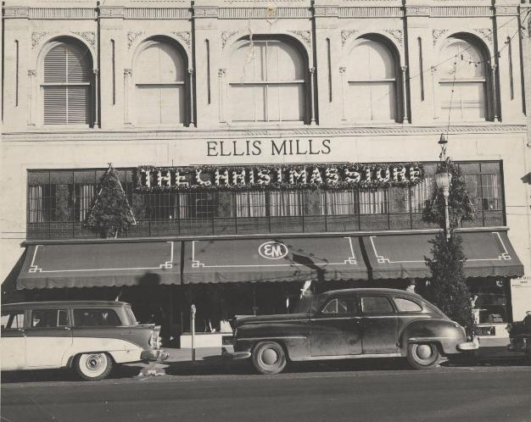
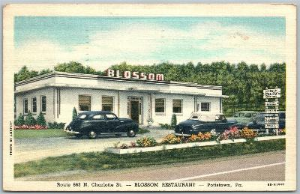
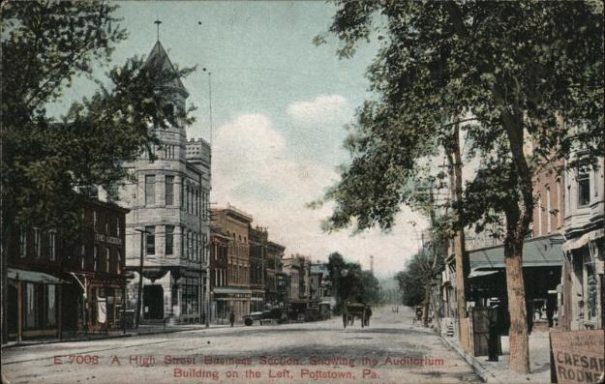
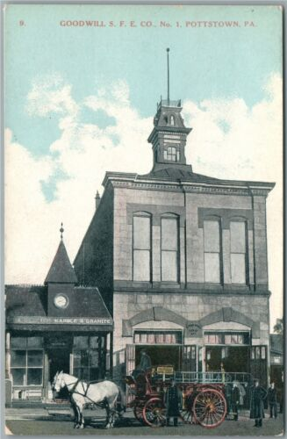
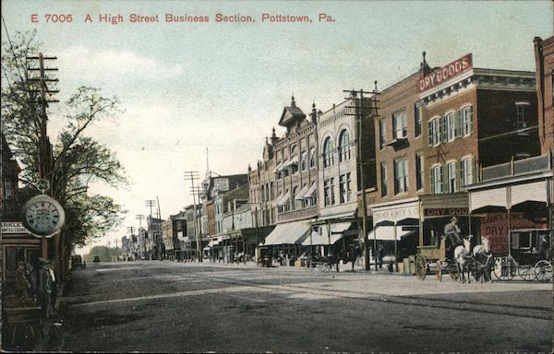
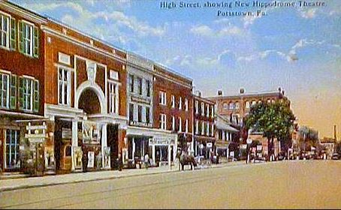
Pottstown has impressive, historic, streetscape “bones”

Slide 6
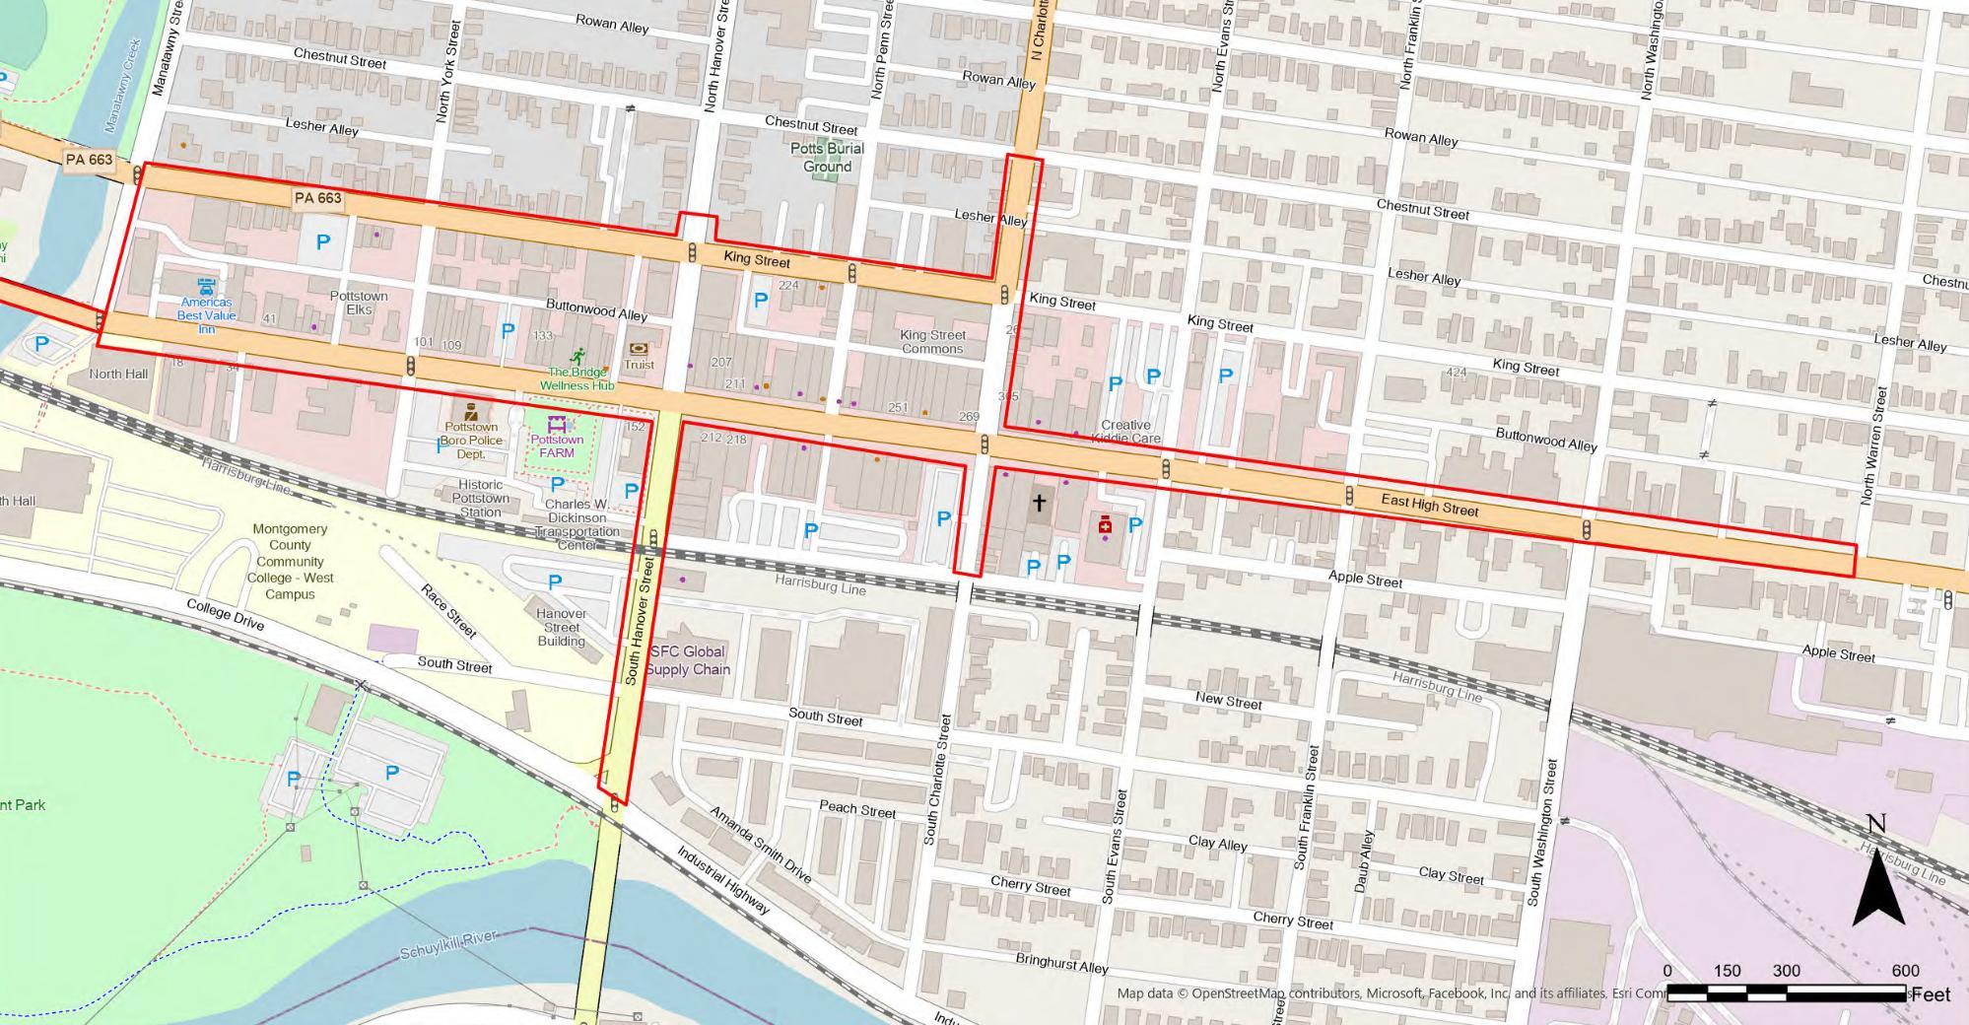
Project Area | Downtown

Slide 7
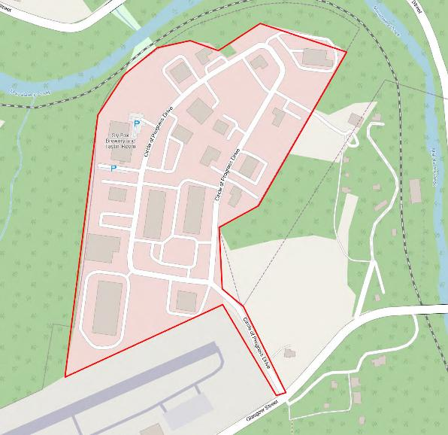
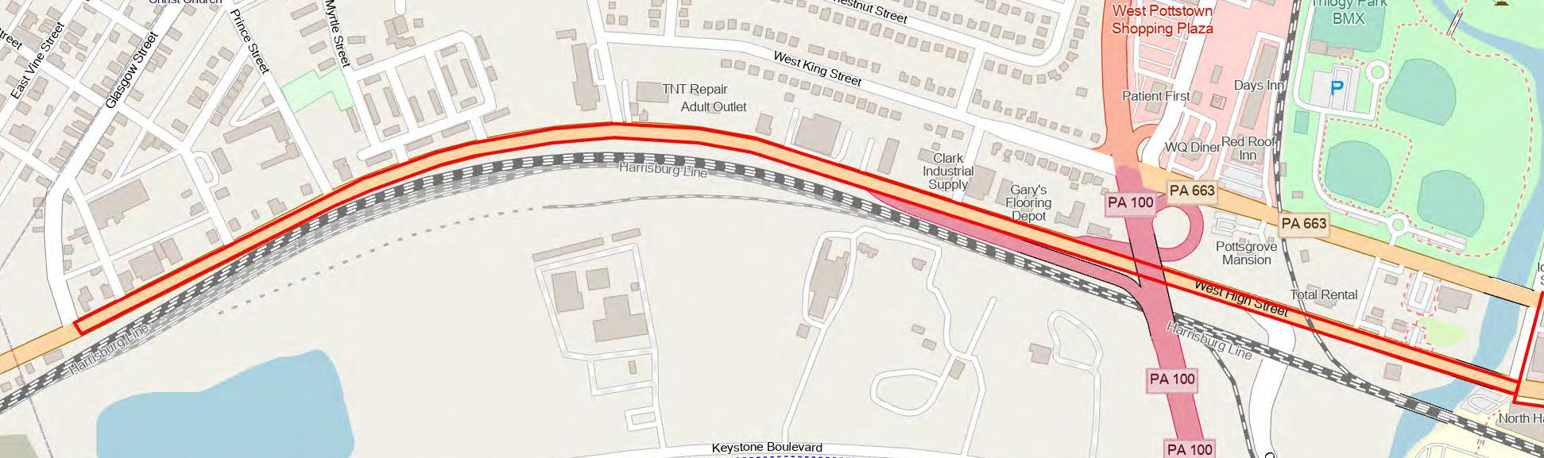
Project Area | West High St +
Circle of Progress

Slide 8
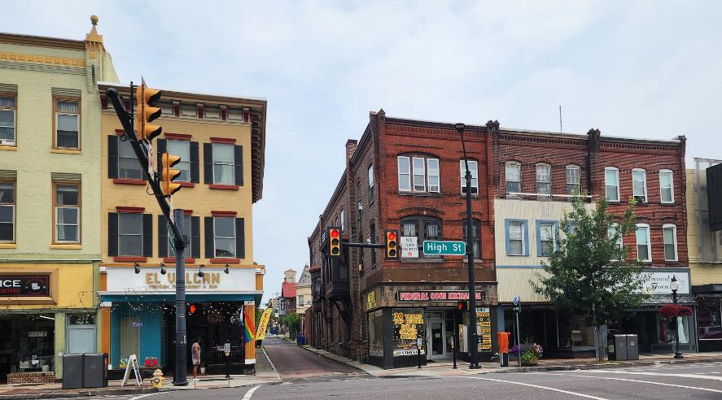
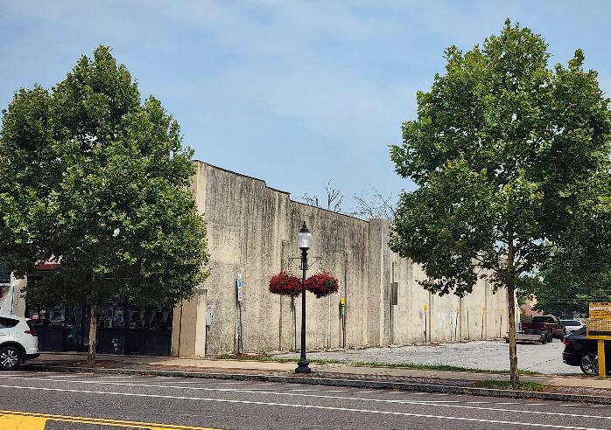
Project Approach
Scope of work:
  Document existing conditions / photo inventory
  Recommendations for enhanced streetscape & facades
  Identify priorities & projects applicable for grants
Notes:
I feel like the most value will be in identifying opportunities – what buildings might bring the most value to the streetscape if they were restored? What properties might be candidates for a little work goes a long way? Those two lists might inform the priorities.

Slide 9
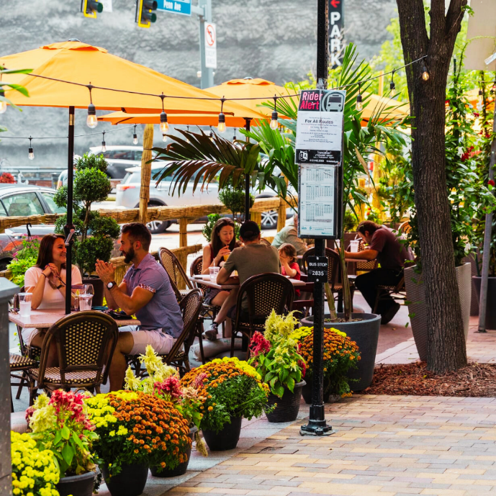
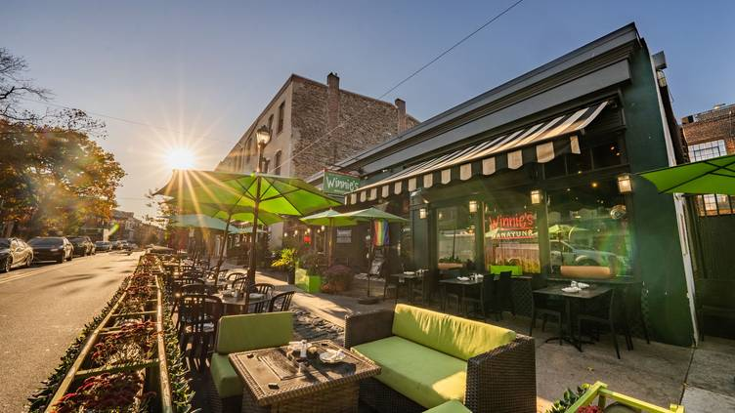
Project Approach
Likely Improvements / Possible Approaches
  Explore areas to expand outdoor dining
Notes:
I feel like the most value will be in identifying opportunities – what buildings might bring the most value to the streetscape if they were restored? What properties might be candidates for a little work goes a long way? Those two lists might inform the priorities.

Slide 10
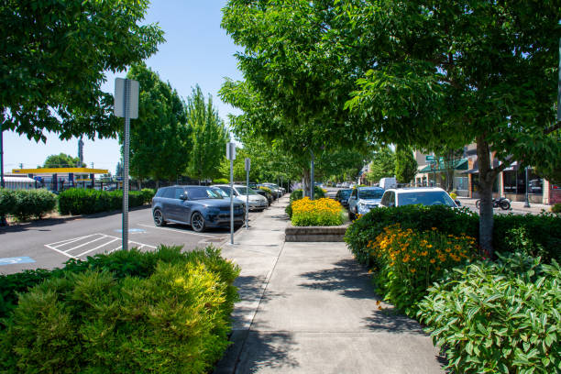
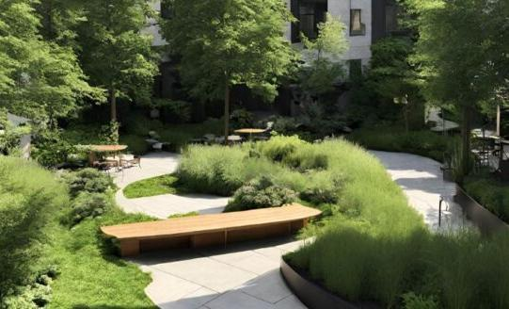
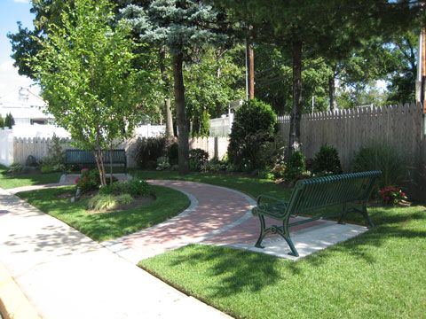
Project Approach
Likely Improvements / Possible Approaches
  Identify community gathering spaces: “mini plazas”, new parklets
Notes:
I feel like the most value will be in identifying opportunities – what buildings might bring the most value to the streetscape if they were restored? What properties might be candidates for a little work goes a long way? Those two lists might inform the priorities.

Slide 11
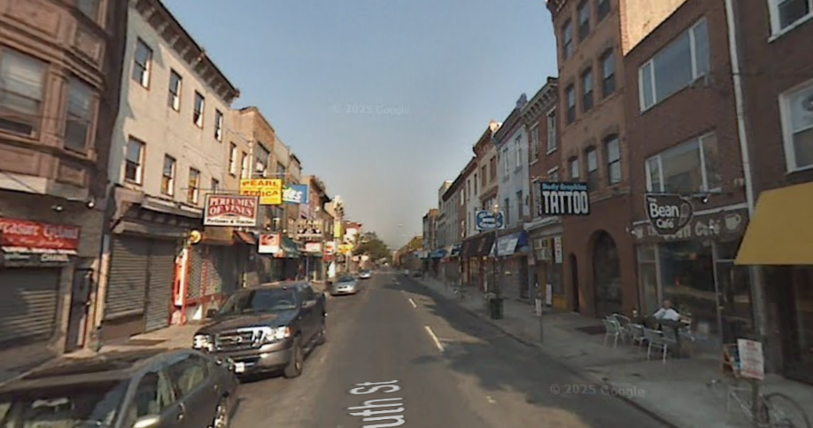
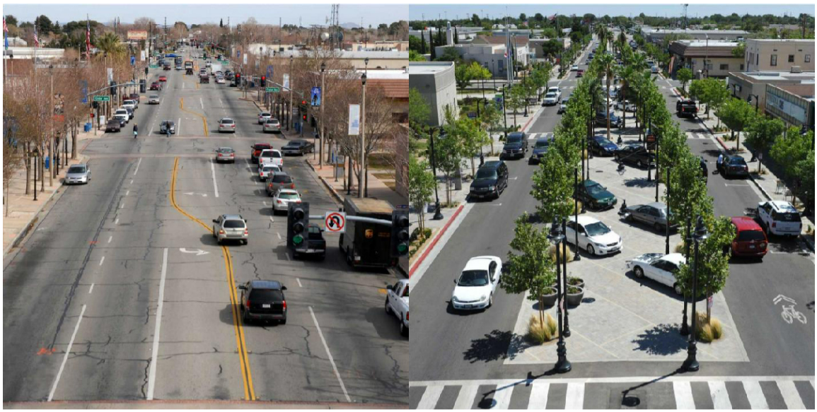
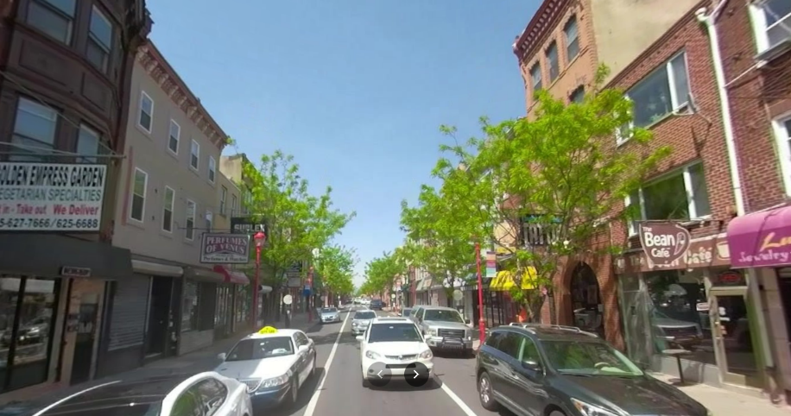
Project Approach
Likely Improvements / Possible Approaches
  Add street trees
Notes:
I feel like the most value will be in identifying opportunities – what buildings might bring the most value to the streetscape if they were restored? What properties might be candidates for a little work goes a long way? Those two lists might inform the priorities.

Slide 12
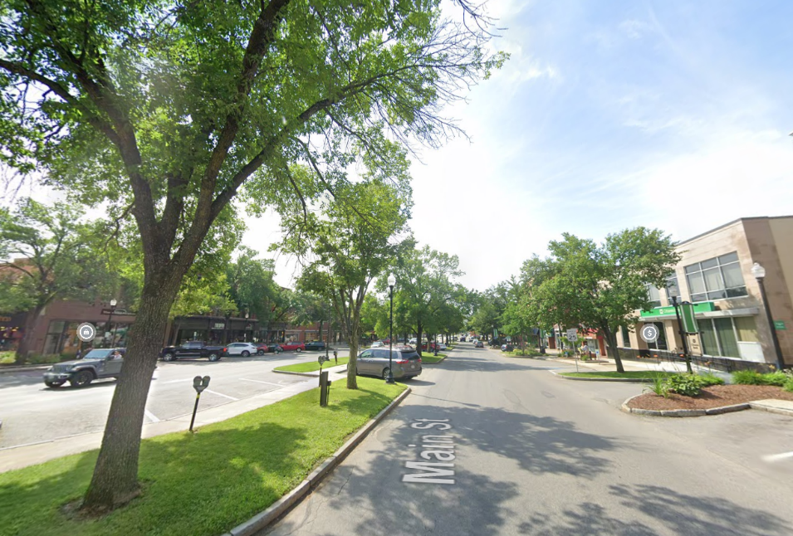
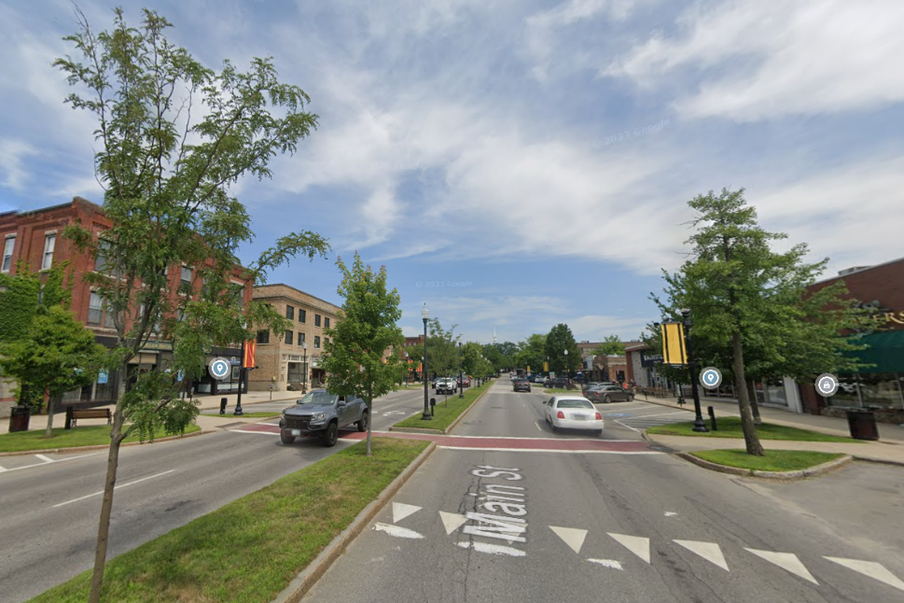
Project Approach
Likely Improvements / Possible Approaches
  Consider green median on High St.
  (beautification, traffic calming, easier pedestrian x-ing, stormwater mgmt.)
Notes:
I feel like the most value will be in identifying opportunities – what buildings might bring the most value to the streetscape if they were restored? What properties might be candidates for a little work goes a long way? Those two lists might inform the priorities.

Slide 13
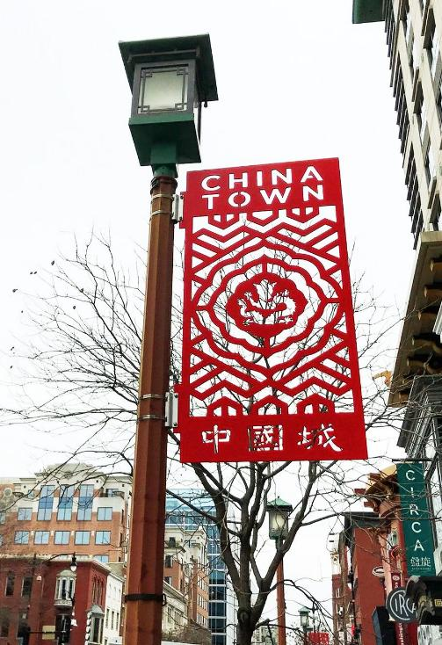
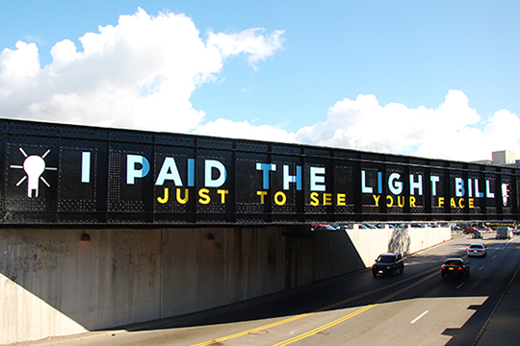
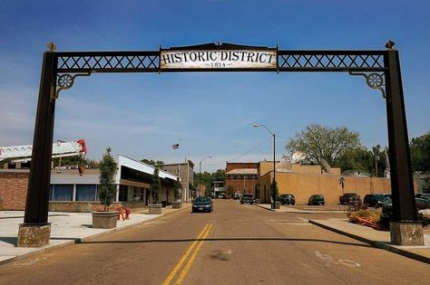
Project Approach
Likely Improvements / Possible Approaches
  Gateways to define downtown
Notes:
I feel like the most value will be in identifying opportunities – what buildings might bring the most value to the streetscape if they were restored? What properties might be candidates for a little work goes a long way? Those two lists might inform the priorities.

Slide 14
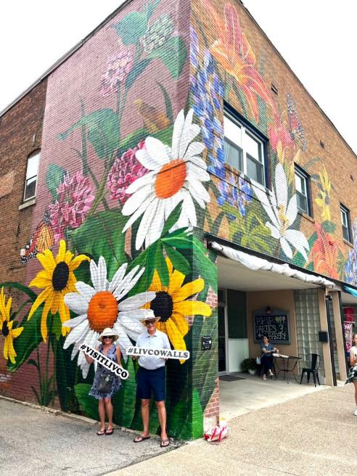
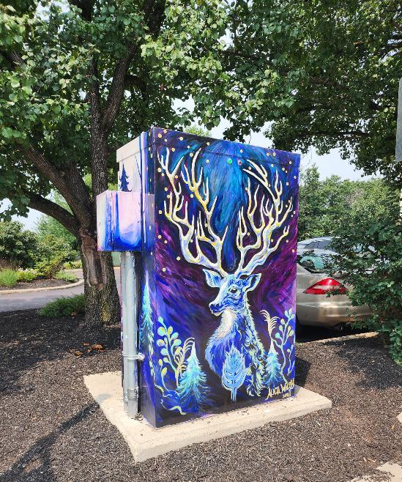
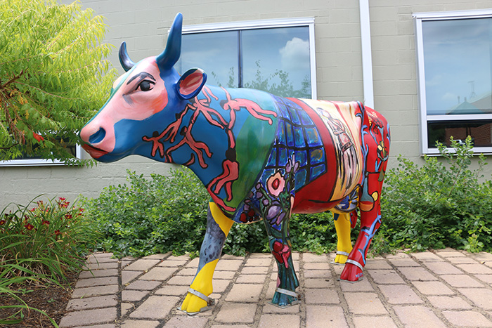
Project Approach
Likely Improvements / Possible Approaches
  Street Art: Identify local artists, painted “cow” model?
  Public Art/Murals
Notes:
I feel like the most value will be in identifying opportunities – what buildings might bring the most value to the streetscape if they were restored? What properties might be candidates for a little work goes a long way? Those two lists might inform the priorities.

Slide 15
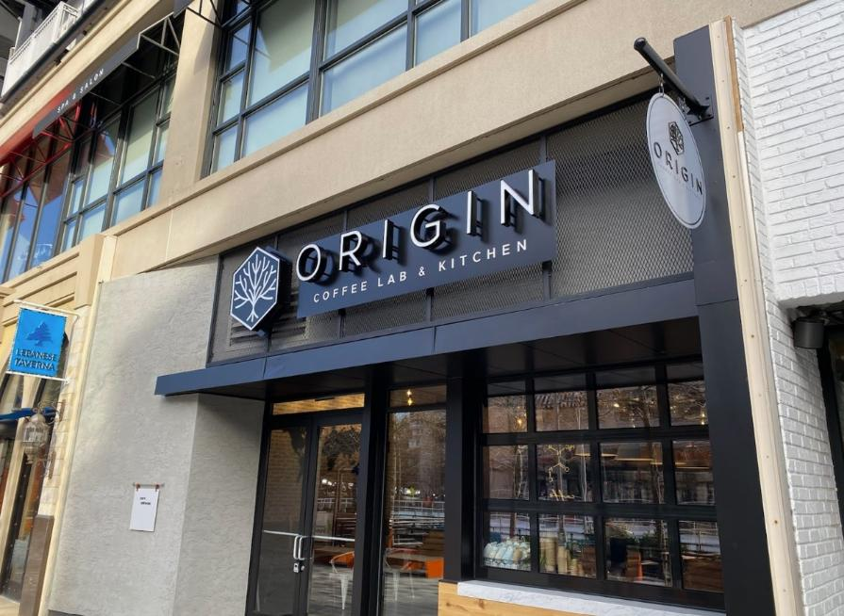
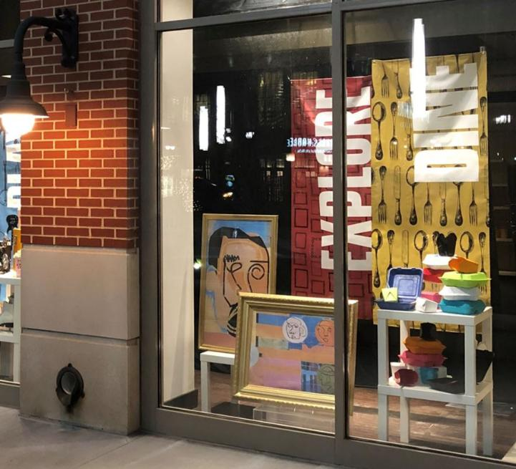
Project Approach
Building Façade Improvements – Recommendation Types
  Signage, vacant storefront displays

Slide 16
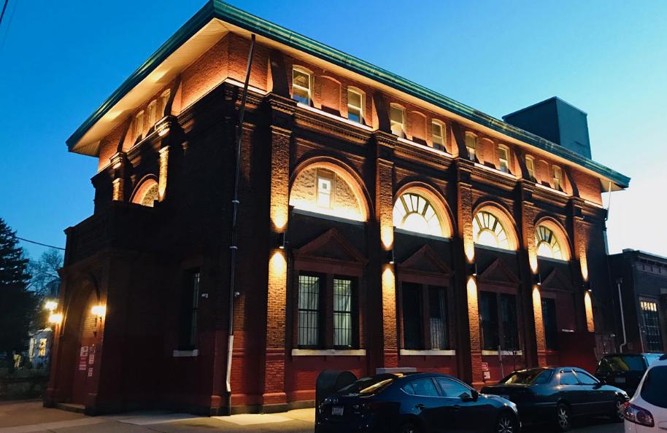
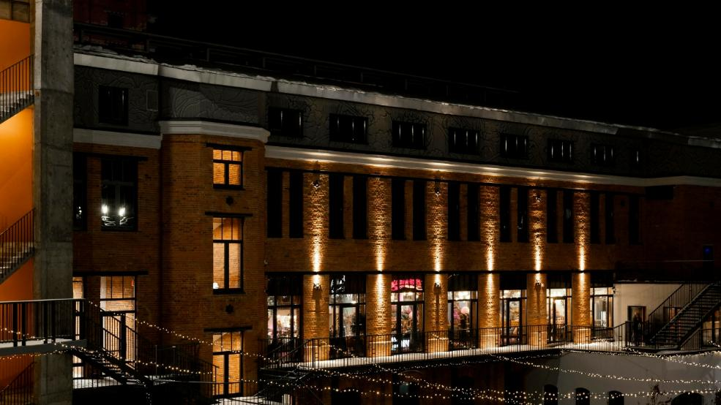
Project Approach
Building Façade Improvements – Recommendation Types
  Façade lighting

Slide 17
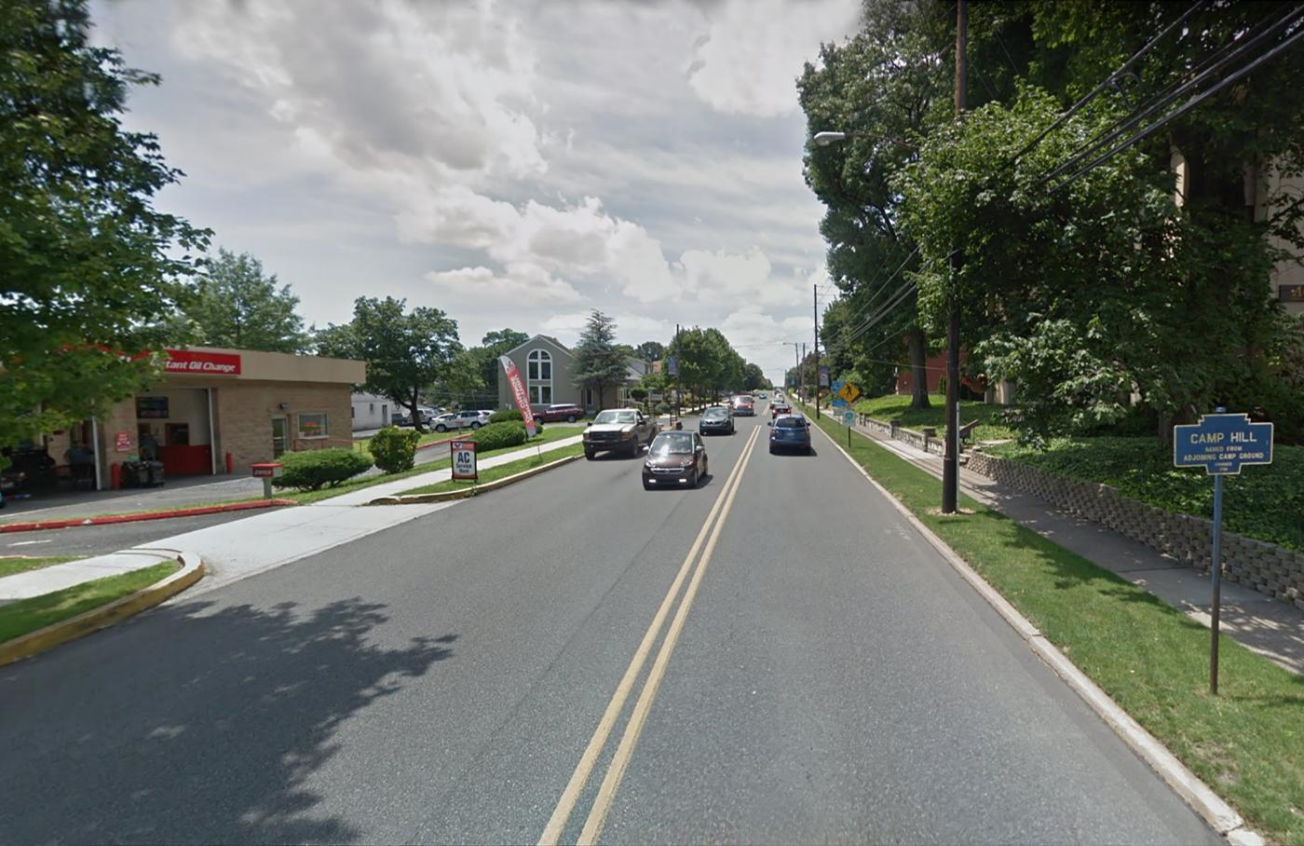
Communication | Photo Simulations
A minimum of 15 photo-simulations / renderings
Market St. near 15th St. - Before

Slide 18
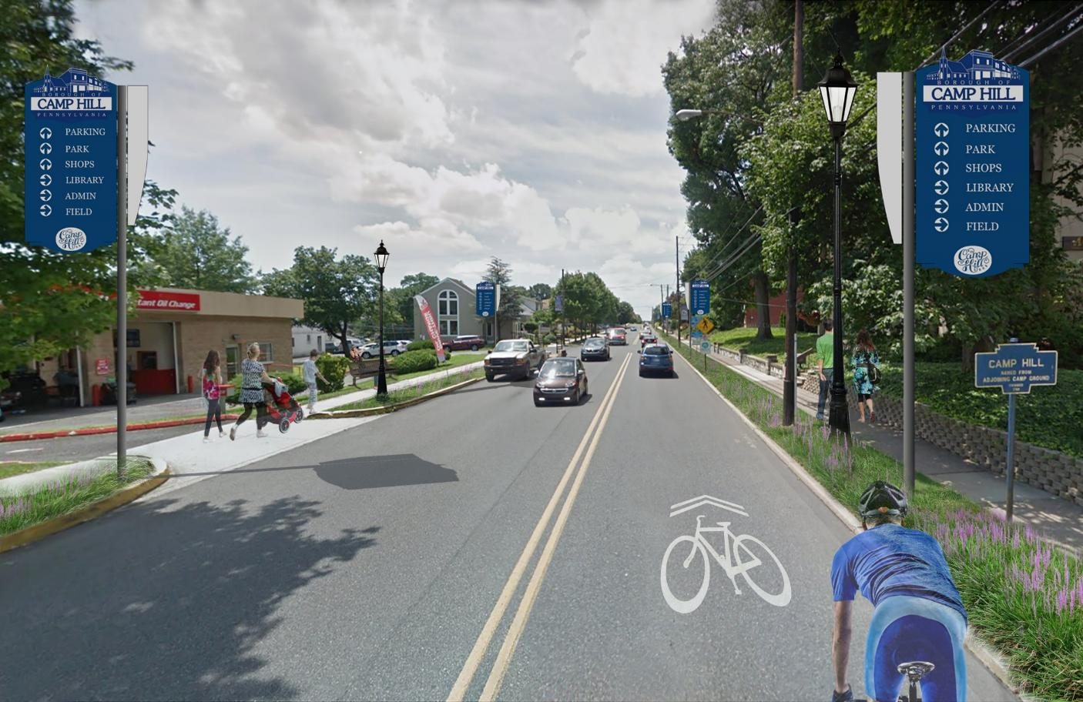
Communication | Photo Simulations
Market St. near 15th St. - After

Slide 19
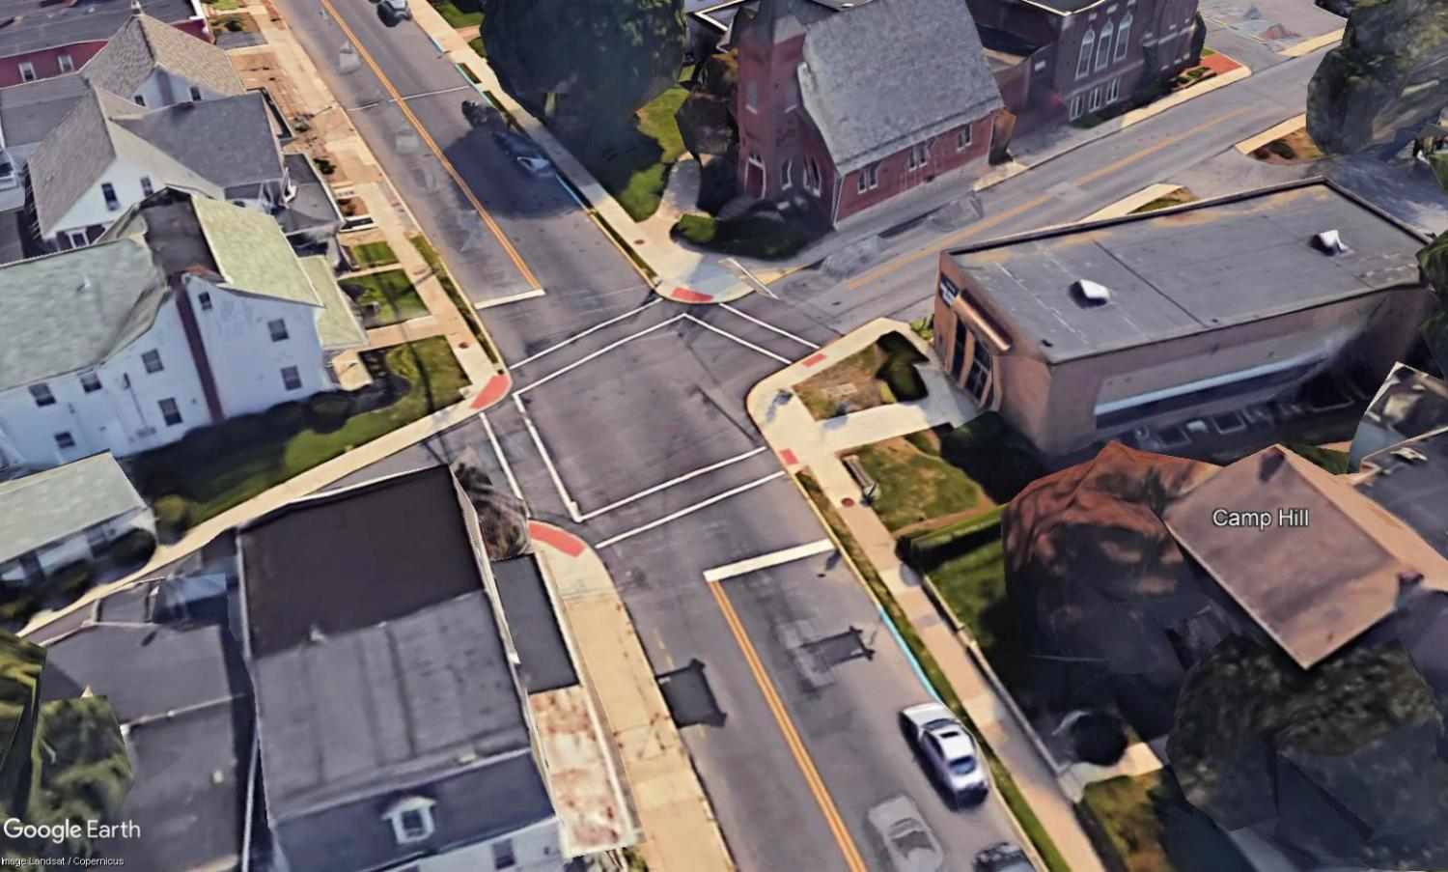
Communication | Photo Simulations
Market St. at 21st St. - Before

Slide 20
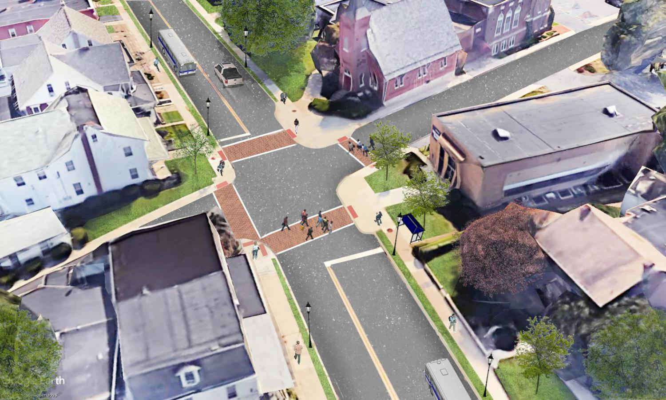
Communication | Photo Simulations
Market St. at 21st St. - After

Slide 21
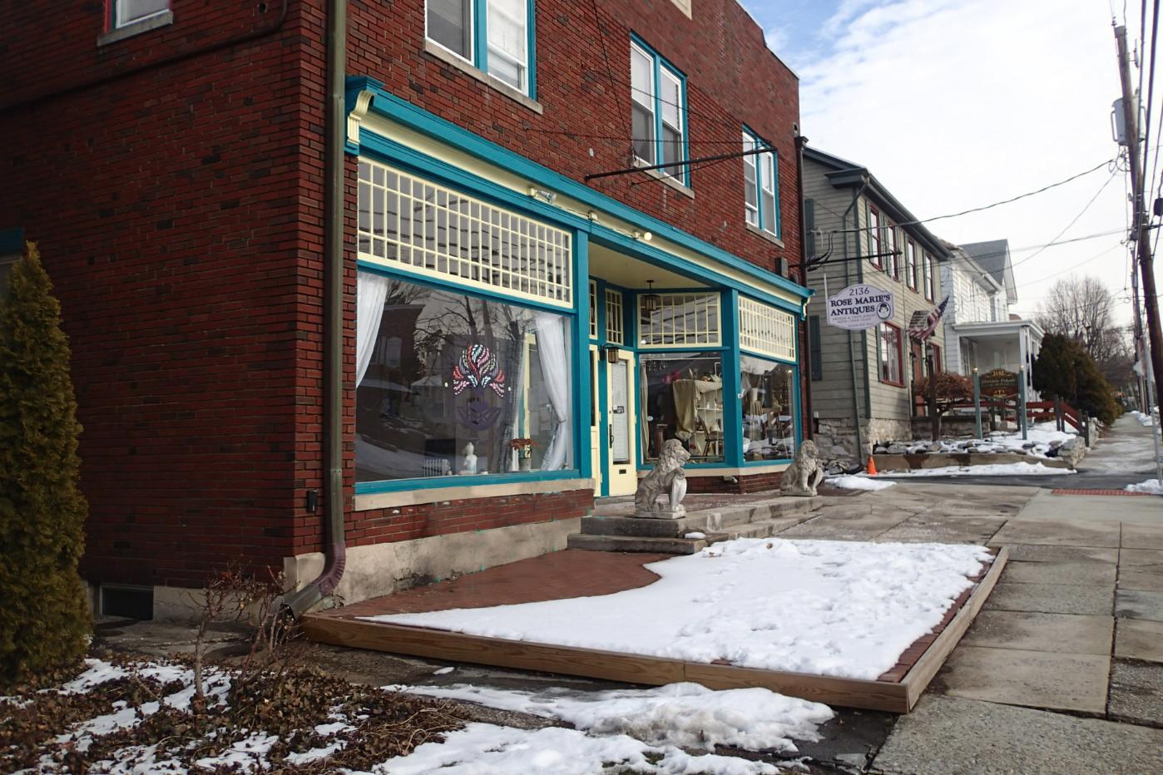
Communication | Photo Simulations

Slide 22
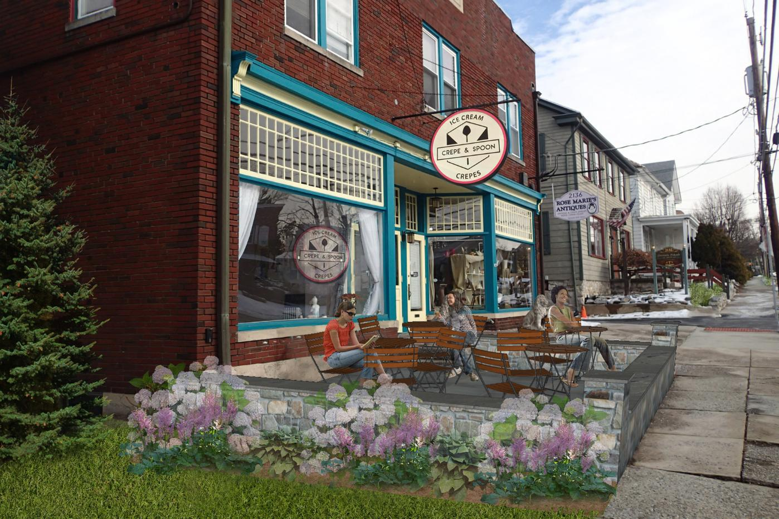
Communication | Photo Simulations

Slide 23
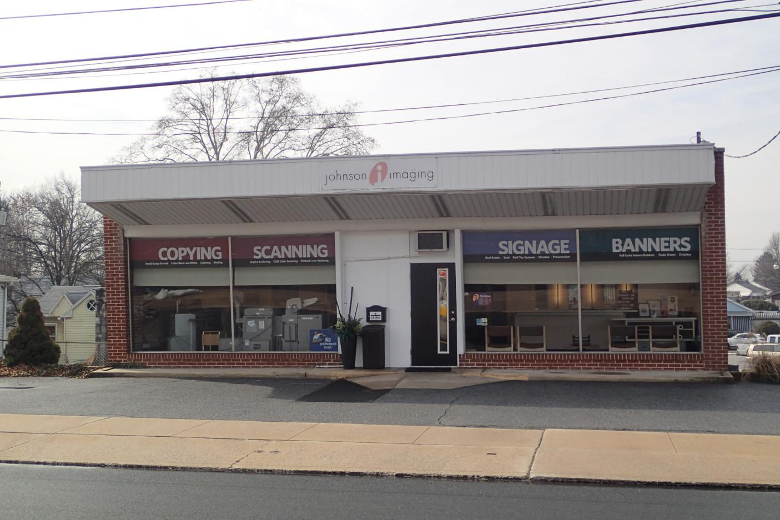
Communication | Photo Simulations
Johnson Imaging - Before

Slide 24
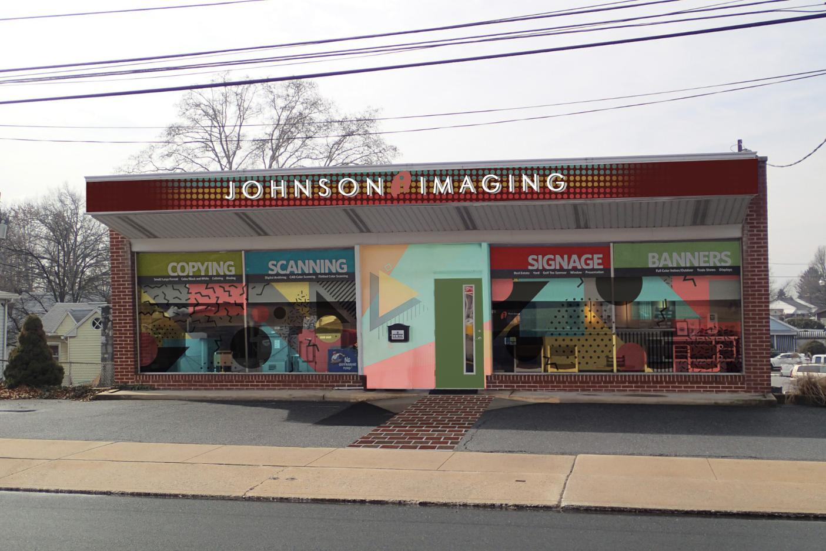
Communication | Photo Simulations
Johnson Imaging - After

Slide 25
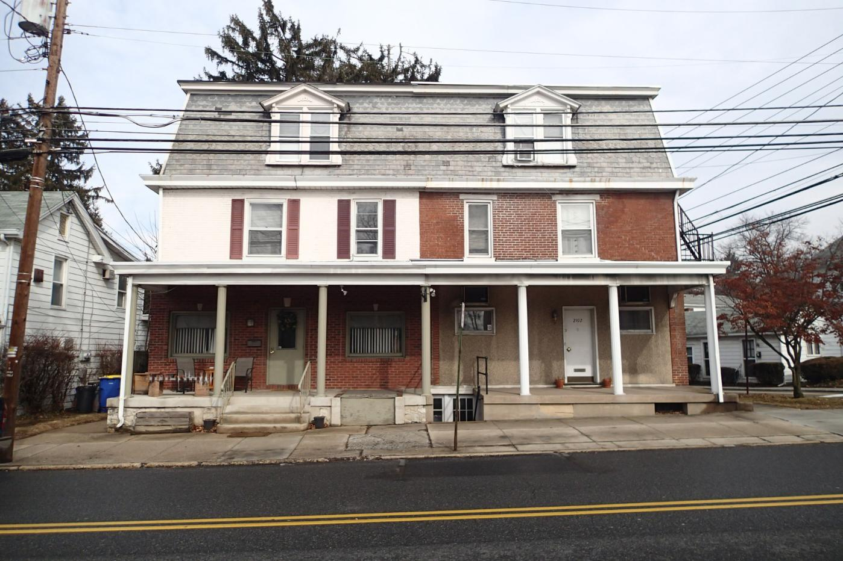
Communication | Photo Simulations
2102 Market St. - Before

Slide 26
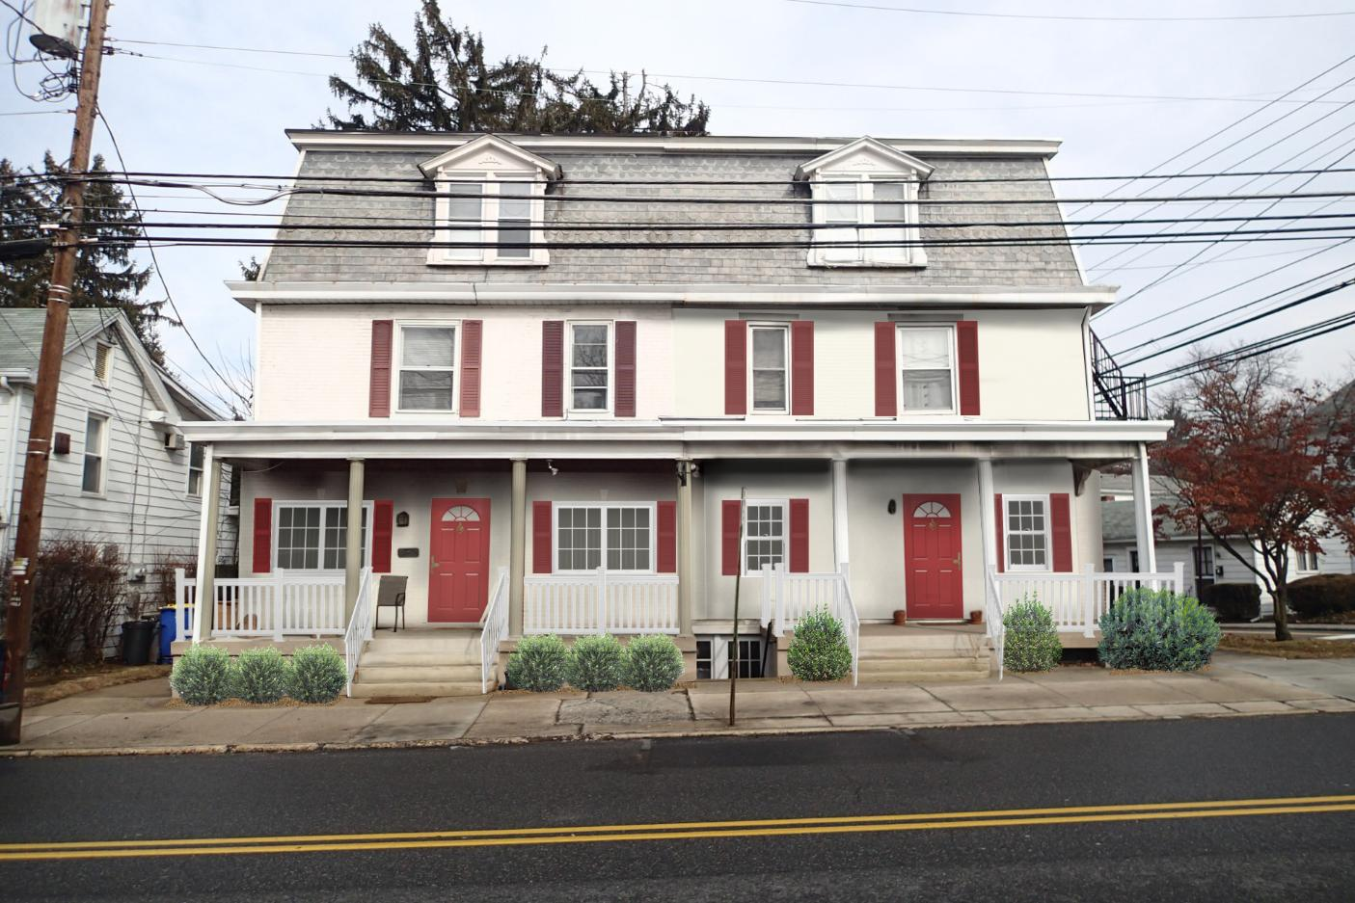
Communication | Photo Simulations
2102 Market St. - Before

Slide 27
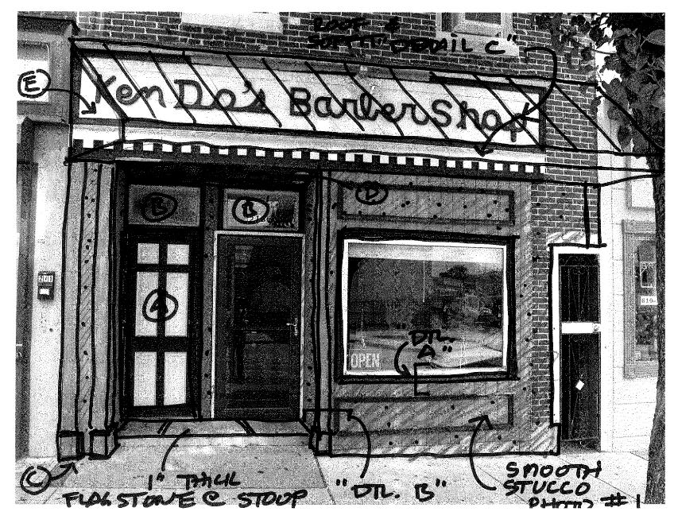
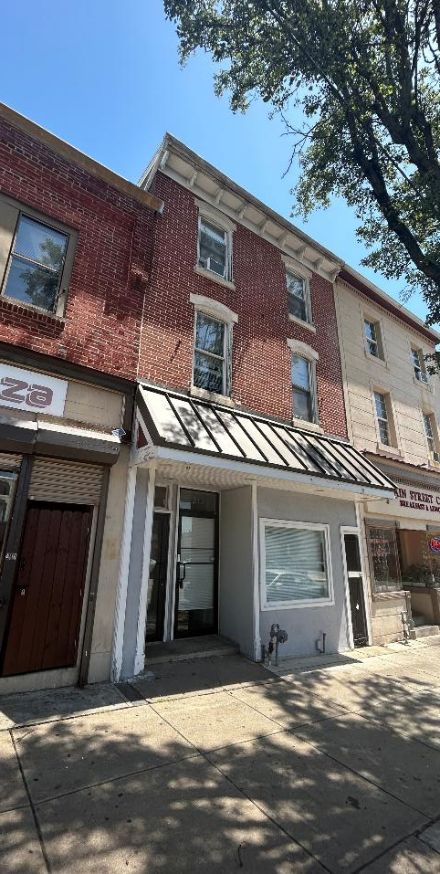
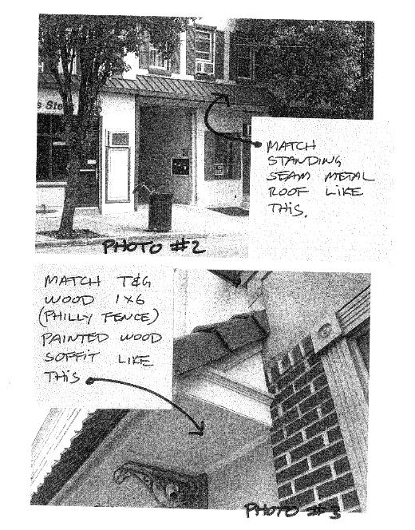
Communication | Before & After
Norristown Barber Shop

Slide 28
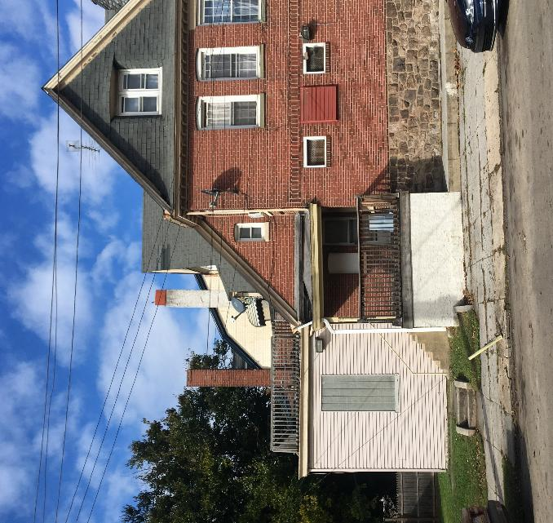
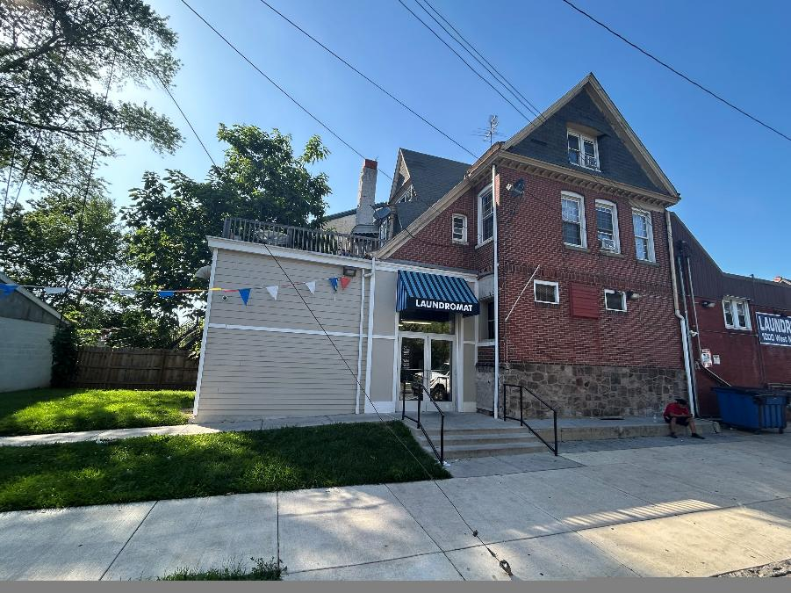
Communication | Before & After
Laundromat

Slide 29
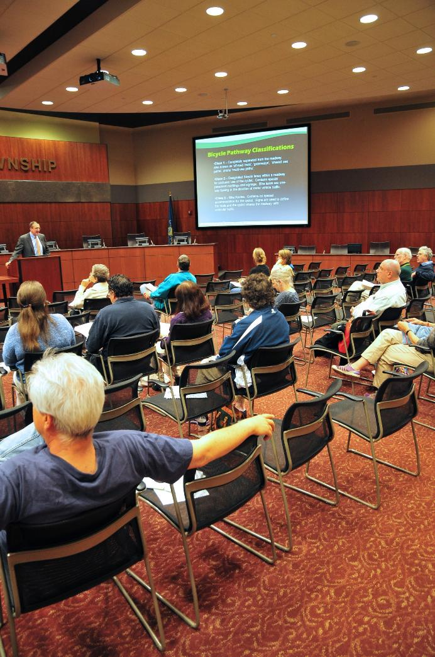
Project Approach
Public, Stakeholder, & Agency Coordination
4 meetings with PAED
2 meetings with Property and Business Owners
2 public meetings (this is #1)
1 meeting with Borough Staff
1 meeting with PennDOT
6 key person / key agency interviews

Slide 30
Project Approach
Coordination with Ongoing Borough Studies & Initiatives:
  Signage Ordinance Update (Montgomery County Planning Commission)
  Sidewalk / Street Trees Improvements (Pottstown Borough)
  PART Bus Shelter Replacements (PART)
  Lighting Initiatives – “Light Up High Street” (Pottstown Borough)
  Stormwater Management (MS4 Credits) – porous paving in alleys
  (Pottstown Borough)
  Train Station Area Plan (DVRPC)

Slide 31


Slide 32


Slide 33


Slide 34


Slide 35


Slide 36


Slide 37


Slide 38


Slide 39


Slide 40


Slide 41


Slide 42


Slide 43



High St. (west of Rt. 100)
Opportunities & challenges along West High Street
  Bike Lanes in place – good start
  Opportunities for Street Tree Plantings in right-of-way
  Some lots have unlimited curb cuts – rectify for safety
  Gateway signage on bridge? / or other location
  Work with PennDOT District 6-0 to understand constraints
  (also for Downtown)

Slide 44




Circle of Progress
Opportunities & Challenges
  Good street trees
  Met with property owners
  Entryway landscape enhancements

Slide 45
Brainstorming
Where are the opportunities in the project area?
What are the primary physical concerns to be addressed?
How best to position recommendations for funding?
What are the low hanging fruit to implement soon?

Slide 46
Schedule – Public Mtg #2 – December 10

